Slide 1




Steel Defect detection
By:
Ch Sai Naveen
180030534

Slide 2
Introduction:
Steel is one of the most important building materials of modern times. Steel buildings are resistant to natural and man-made wear which has made the material ubiquitous around the world.
This is main reason that let the growth of steel usage in the construction of buildings . Even Amazon’s largest campus building in Hyderabad is Built with over 2.5 times more steel than the Eiffel Tower
To help make production of steel more efficient Steel Defect Detection is a competition hosted on Kaggle by one of the largest steel manufacture company Severstal .

Slide 3
Abstract:
The production process of flat sheet steel is especially delicate. From heating and rolling, to drying and cutting, several machines touch flat steel by the time it’s ready to ship.
The objective of this model is to predict the location and type of defects found in steel manufacturing using the images provided and get the perfect measures that gives the best scores.
Here we have taken a data set containing approx. 6000 images of steel with defects and 6000 images of steel without defect to train our model through semantic segmentation catboost classifier to get the results of best possible scores.

Slide 4
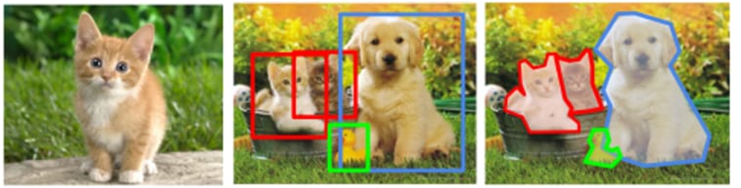
Application:-
In this model we use Semantic segmentation for the detections of defect areas on the steel from the image
Why Semantic Segmentation ? Why not object detection ?
Semantic Segmentations detects with respective to the pixels with shapes such just we can get the exact details of information and leave the unwanted data.

Slide 5
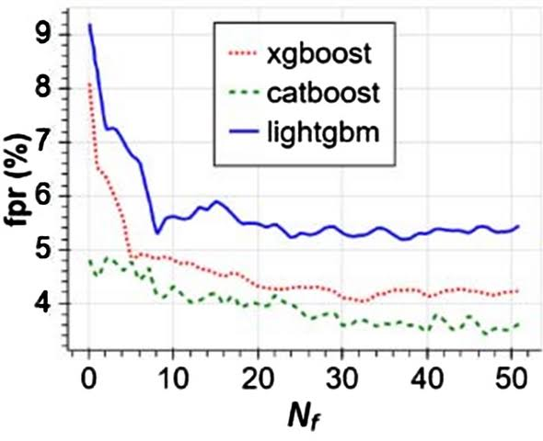
We train our model with approx. 12k images of which around 6k with defects and 6k without defects to make the model learn the differences between the images with defects and images without defects .
Then we test the model to evaluate the images using the Catboost classifier and find the best possible measure to get the best scores using Learning rate and AUC curve.
Why Catboost classifier ?
By chart we can say that catboost classifier has less loss compared to other classifiers i.e catboost classifier is more accurate then the other classifiers

Slide 6
References:-
Understanding Convolution for Semantic Segmentation
Detection of steel defect using the image processing algorithm
Comparison of the CatBoost Classifier with other classifiers

Slide 7


